Slide 1
Biol 7200: Programming for Bioinformatics Symlinks and regex

Slide 2
Plan for today
Recap – files, dirs, inodes
Links – hard and soft
Regex (regular expressions)

Slide 3
Plan for today
Recap – files, dirs, inodes
Links – hard and soft
Regex (regular expressions)

Slide 4
Linux File System
On a UNIX system, almost everything is given a filehandle (address in the filesystem).
See this week’s reading for more details!
Type | Symbol | Description
Regular | - | Regular file
Directories | d | List of other files
Links | l | Links (shortcuts) to other files
Character device | c | Type of special file – serial access only
Block device | b | Type of special file – supports random access
Sockets | s | provide inter-process networking
Named pipes | p | like sockets, w/o network socket semantics
Need to know
Outside course
scope

Slide 5
Unix files can be thought of as having 3 levels
Filename lookup
Filename
inode number
inode table
inode number
Owner/group
Permissions
Etc…
Data locations …
Data blocks on hard drive
Data
Data
…

Slide 6
Files contain data as you would expect
Filename lookup
Filename
inode number
inode table
inode number
Owner/group
Permissions
Etc…
Data locations …
Data blocks on hard drive
Data
Data
…
"The quick brown fox
jumps over the lazy dog"
Data

Slide 7
Directories are files that contain a table of inodes
Filename lookup
Filename
inode number
inode table
inode number
Owner/group
Permissions
Etc…
Data locations …
Data blocks on hard drive
Data
. <self inode number>
.. <parent inode number>
file1 <file1 inode number>
etc…
Data

Slide 8
Mv renames files cp copies the whole structure
Filename lookup
Filename
inode number
New filename
inode table
inode number
Owner/group
Permissions
Etc…
Data locations …
Data blocks on hard drive
Data
. <self inode number>
.. <new parent inode number>
file1 <file1 inode number>
etc…
. <self inode number>
.. <parent inode number>
file1 <file1 inode number>
etc…
Data

Slide 9
A simpler view
Filename lookup
Filename
inode number
inode table
inode number
Metadata
Data locations …
Data blocks on hard drive
Data

Slide 10
Plan for today
Recap – files, dirs, inodes
Links – hard and soft
Regex (regular expressions)

Slide 11
A link is a file with the same structure as other files
Filename lookup
Filename
inode number
inode table
inode number
Metadata
Data locations …
Data blocks on hard drive
Data
Links are defined by their relationships with other files

Slide 12
Hard links are files that point to the same inode
Filename lookup
Filename1
inode number
Filename2
inode number
inode table
inode number
Metadata
Data locations …
Data blocks on hard drive
Data
In this setup, both files are said to be hardlinked

Slide 13
The data associated with soft links (symlinks) is a path
Filename lookup
Filename1
inode number
inode table
inode number
Metadata
Data locations …
Data blocks on hard drive
Data
Filename2
inode number
“/path/to/filename2”
…
The path is followed when Filename1 is opened

Slide 14
Link demo

Slide 15
Plan for today
Recap – files, dirs, inodes
Links – hard and soft
Regex (regular expressions)

Slide 16
Quick note about grep and regex
Different grep implementations behave differently when handling some regex patterns
We’re focused on Ubuntu and therefore GNU grep
Mac grep may perform differently so you may wish to install GNU grep with Mamba

Slide 17
Regex goals
Regex can be very complex
Regex are very useful
My goal is to introduce you and make you aware of the possibilities of regex
You do not need to be able to write them from memory
You should be able to build them with time, experimentation, and a reference

Slide 18
Why is it worth using regex?
Demo/teaser
Notes:
Regex used in demo: .*(?<!^)([[:upper:]][[:lower:]]+) ([[:lower:]]+).*
Replace string used: Species: \2\tGenus: \1

Slide 19
Regex plan
Escape characters
Extended regex
Quantifiers
Anchors
Bracket expressions and character classes
Match groups
Demo
Perl regex
Lazy quantifiers
Lookarounds
Demo

Slide 20
Regex resources
Detailed descripts, examples, and reference tables for different varieties of regex https://www.regular-expressions.info/
Build, test, explain regex (like explainshell.com) https://regexr.com/
Regex interactive lessons https://regexone.com/
Regex game! https://regexcrossword.com/

Slide 21
Regex plan
Escape characters
Extended regex
Quantifiers
Anchors
Bracket expressions and character classes
Match groups
Demo
Perl regex
Lazy quantifiers
Lookarounds
Demo

Slide 22
Escape characters negate metacharacters
Escape characters negate the special meaning of special characters
You’ve already been using escape characters. E.g.,
White space delimits inputs, except in “” or ‘’
$ declares variables except in ‘’
Another escape character is \

Slide 23
\ gives function to some regular characters
\ followed by certain characters refers to special characters
We already saw “\r” (carriage return) to remove Windows line endings
Common examples:
\t – tab
\n – newline
\r – carriage return

Slide 24
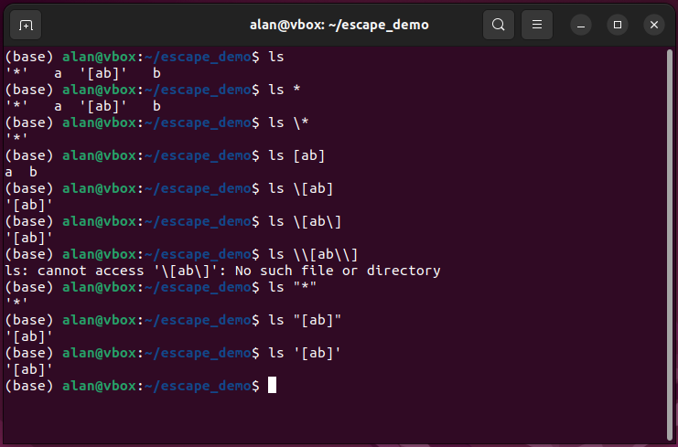
Escaping globs

Slide 25
Regex plan
Escape characters
Extended regex
Quantifiers
Anchors
Bracket expressions and character classes
Match groups
Demo
Perl regex
Lazy quantifiers
Lookarounds
Demo

Slide 26
Extended regex - intro
Extended regex (GNU ERE) defines a set of metacharacters (special characters) to describe strings
Same idea as glob, but more characters with more behaviours
Allows you to match strings using targetable patterns (more powerful than glob)
Supported by many Unix tools but less powerful than Perl regex

Slide 27
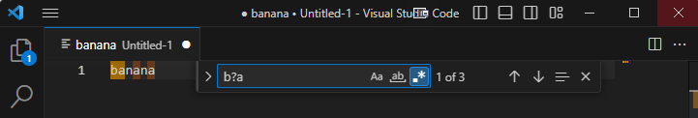
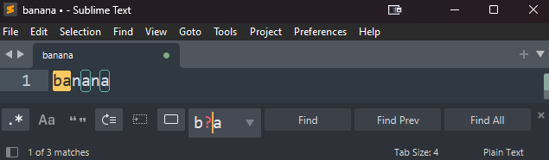
Note: Some text editors support regex search/replace
Click the “.*” button in “find” to activate regex mode in Sublime Text and VS Code

Slide 28
Why use regex? A few example use-cases
Allows you to specify acceptable/unacceptable character sets
PHYLIP Tree format forbids “[()\[\],:;]” in sample names
Check if a .fasta is DNA, RNA, or protein based on alphabet used
Describe sequence motifs
Bioinformatic data formats often rely on context to indicate what data are. E.g.,
Fasta: characters after “>” are header (>sequence1)
XML: characters between flags are content (<species>Homo sapiens<\species>)
SAM format: 6th column has letter codes describing match info (50S100M5I2D10M10H)
Allows sophisticated find and replace in Bash one-liners

Slide 29
Regex plan
Escape characters
Extended regex
Quantifiers
Anchors
Bracket expressions and character classes
Match groups
Demo
Perl regex
Lazy quantifiers
Lookarounds
Demo

Slide 30
Extended regex - quantifiers
Metacharacter | Quantity | Example string | Example regex | Matched string
? | 0 or 1 | Brazen aardvarks | a?r | Brazen aardvarks
* | 0 or more | Brazen aardvarks | a*r | Brazen aardvarks
+ | 1 or more | Brazen aardvarks | a+r | Brazen aardvarks
{n} | Exactly n | Brazen aardvarks | a{2}r | Brazen aardvarks
{n,m} | Between n and m, inclusive | Brazen aardvarks, raaaarrr!!! | a{2,}r | Brazen aardvarks, raaaarrr!!!
Metacharacter | Quantity | Example string | Example regex | Matched string
? | 0 or 1 | Brazen aardvarks | a?r | Brazen aardvarks
* | 0 or more | Brazen aardvarks | a*r | Brazen aardvarks
+ | 1 or more | Brazen aardvarks | a+r | Brazen aardvarks
{n} | Exactly n | Brazen aardvarks | a{2}r | Brazen aardvarks
{n,m} | Between n and m, inclusive | Brazen aardvarks, raaaarrr!!! | a{2,}r | Brazen aardvarks, raaaarrr!!!

Slide 31
Regex plan
Escape characters
Extended regex
Quantifiers
Anchors
Bracket expressions and character classes
Match groups
Demo
Perl regex
Lazy quantifiers
Lookarounds
Demo

Slide 32
Extended regex - anchors
Anchors match a location
Anchors don’t have width (i.e., they can match in between characters)
Metacharacter | Location matched | Example string | Example regex | Matched string
^ | Beginning of line | a bowl of salsa | ^a | a bowl of salsa
$ | End of line | a bowl of salsa | a$ | a bowl of salsa
\b | Word boundary | a bowl of salsa | \ba|a\b | a bowl of salsa
\B | Not word boundary | a bowl of salsa | \Ba\B | a bowl of salsa
Metacharacter | Location matched | Example string | Example regex | Matched string
^ | Beginning of line | a bowl of salsa | ^a | a bowl of salsa
$ | End of line | a bowl of salsa | a$ | a bowl of salsa
\b | Word boundary | a bowl of salsa | \ba|a\b | a bowl of salsa
\B | Not word boundary | a bowl of salsa | \Ba\B | a bowl of salsa

Slide 33
Regex plan
Escape characters
Extended regex
Quantifiers
Anchors
Bracket expressions and character classes
Match groups
Demo
Perl regex
Lazy quantifiers
Lookarounds
Demo

Slide 34
Bracket expressions define a set of characters
Can be literal characters, like in glob
e.g., [abc] matches a, b, or c
Can be negated, like in glob
glob [!abc] matches anything other than a, b, or c
Regex negation character is ^
Can be ranges of characters (in alphabetical/numerical order)

Slide 35
Extended regex- bracket expression
Bracket expression | meaning | Example string | Example regex | Matched string
[…] | One of the given characters | 1 Banana | [abc] | 1 Banana
[^...] | One of a character other than the given characters | 1 Banana | [^abc] | 1 Banana
[0-2a-cA-C] | one of the characters in the given ranges (inclusive) | 1 Banana | [0-2a-cA-C] | 1 Banana
Bracket expression | meaning | Example string | Example regex | Matched string
[…] | One of the given characters | 1 Banana | [abc] | 1 Banana
[^...] | One of a character other than the given characters | 1 Banana | [^abc] | 1 Banana
[0-2a-cA-C] | one of the characters in the given ranges (inclusive) | 1 Banana | [0-2a-cA-C] | 1 Banana

Slide 36
Character classes are special strings which refer to a type of character
Equivalent to a range in a bracket expansion
Must be within a bracket expansion

Slide 37
Extended regex – Character classes
Character class | Equivalent bracket expression | Example string | Example regex | Matched string
[[:alpha:]] | [A-Za-z] | 012!\tabc DEF_ | [[:alpha:]]+ | 012!\tabc DEF_
[[:digit:]] | [0-9] | 012!\tabc DEF_ | [[:digit:]]+ | 012!\tabc DEF_
[[:alnum:]] | [A-Za-z0-9] | 012!\tabc DEF_ | [[:alnum:]]+ | 012!\tabc DEF_
[[:space:]]|\s | [ \t\n\r] | 012!\tabc DEF_ | [[:space:]]+ | 012!\tabc DEF_
[[:upper:]] | [A-Z] | 012!\tabc DEF_ | [[:upper:]]+ | 012!\tabc DEF_
[[:lower:]] | [a-z] | 012!\tabc DEF_ | [[:lower:]]+ | 012!\tabc DEF_
\w | [A-Za-z0-9_] | 012!\tabc DEF_ | \w+ | 012!\tabc DEF_
[[:punct:]] | [!"\#$%&'()*+, \-./:;<=>?@\[ \\\]^_`{|}~] | 012!\tabc DEF_ | [[:punct:]] | 012!\tabc DEF_
Character class | Equivalent bracket expression | Example string | Example regex | Matched string
[[:alpha:]] | [A-Za-z] | 012!\tabc DEF_ | [[:alpha:]]+ | 012!\tabc DEF_
[[:digit:]] | [0-9] | 012!\tabc DEF_ | [[:digit:]]+ | 012!\tabc DEF_
[[:alnum:]] | [A-Za-z0-9] | 012!\tabc DEF_ | [[:alnum:]]+ | 012!\tabc DEF_
[[:space:]]|\s | [ \t\n\r] | 012!\tabc DEF_ | [[:space:]]+ | 012!\tabc DEF_
[[:upper:]] | [A-Z] | 012!\tabc DEF_ | [[:upper:]]+ | 012!\tabc DEF_
[[:lower:]] | [a-z] | 012!\tabc DEF_ | [[:lower:]]+ | 012!\tabc DEF_
\w | [A-Za-z0-9_] | 012!\tabc DEF_ | \w+ | 012!\tabc DEF_
[[:punct:]] | [!"\#$%&'()*+, \-./:;<=>?@\[ \\\]^_`{|}~] | 012!\tabc DEF_ | [[:punct:]] | 012!\tabc DEF_
Note: the outer [] form a bracket expression. You can combine/negate these (e.g., [^[:alpha:][:digit]]
the opposite of \w and \s is \W and \S (i.e., uppercase is negated version)

Slide 38
Regex plan
Escape characters
Extended regex
Quantifiers
Anchors
Bracket expressions and character classes
Match groups
Demo
Perl regex
Lazy quantifiers
Lookarounds
Demo

Slide 39
Match groups
Match groups define portions of your pattern you want to refer back to (backreference)
Can use backreferences within a pattern or during a replace operation
Match groups are defined using parentheses “()”
Each match group can be backreferenced using escaped numbers
“(a)(b)(c)” are backreferenced using “\1\2\3”
E.g.,
String “1,2,3,4,1,5,6,7”
Pattern “([0-9]).*(\1)”
Match “1,2,3,4,1”

Slide 40
Regex plan
Escape characters
Extended regex
Quantifiers
Anchors
Bracket expressions and character classes
Match groups
Demo
Perl regex
Lazy quantifiers
Lookarounds
Demo

Slide 41
Regex plan
Escape characters
Extended regex
Quantifiers
Anchors
Bracket expressions and character classes
Match groups
Demo
Perl regex
Lazy quantifiers
Lookarounds
Demo

Slide 42
Perl-compatible regex (pcre) are a newer “flavour”
Regex “flavours” refer to the software (or “engine”) that interprets the pattern and searches for matches
PCRE was inspired by functionality of the Perl programming language
Supported by grep with -P and by Python.
Includes valuable extensions of GNU ERE
We’ll cover some extensions today, but there are more!

Slide 43
Regex plan
Escape characters
Extended regex
Quantifiers
Anchors
Bracket expressions and character classes
Match groups
Demo
Perl regex
Lazy quantifiers
Lookarounds
Demo

Slide 44
Make quantifiers lazy with ?
Adding ? to a quantifier makes it lazy
“.*?”
“.+?”
“{0,2}?”
Etc.

Slide 45
Lazy vs greedy quantifiers
Describes behavior of quantifiers:
Greedy matches as much as it can
Lazy matches as little as it can
Behind the scenes it describes a difference in how the regex engine constructs a match
Each element of regex pattern is processed in turn from left to right
An element is a character or bracket expression plus any quantifiers (e.g., “a+”, “[[:alpha:]]{5,10}”)

Slide 46
Regex engines handle quantifiers by backtracking
Default behavior (greedy) matches as much as possible and then walks back until the whole pattern matches.
E.g., string “xx123xx123xx” and pattern “.*123”
“.*” matches (A.K.A. consumes) “xx123xx123xx” then backtracks until “1” matches, then “2”, then “3”
Final match is “xx123xx123”
Lazy behavior matches as little as possible and then adds characters until the whole pattern matches
E.g., string “xx123xx123xx” and pattern “.*?123”
“.*?” matches nothing then adds characters until “1”, “2”, and “3” matches too
Final match is “xx123”

Slide 47
Regex plan
Escape characters
Extended regex
Quantifiers
Anchors
Bracket expressions and character classes
Match groups
Demo
Perl regex
Lazy quantifiers
Lookarounds
Demo

Slide 48
Lookarounds specify context of the match
Lookarounds aren’t matched, but can apply a rule to matched portion
lookarounds don’t have width (i.e., they can match in between characters)
Lookarounds can control features within matches as well as around matches
“\w*o\w*” matches “bowl” and “of”
“(?=\b\w{4}\b)” specifies 4 word characters between word boundaries (i.e., 4 letter word)
“(?=\b\w{4}\b)\w*o\w*” matches “bowl” but not “of”
metacharacters | Type | Example string | Example regex | Matched string
(?=pattern) | Positive lookahead | a bowl of salsa | \w(?=w) | a bowl of salsa
(?!pattern) | Negative lookahead | a bowl of salsa | a(?!$) | a bowl of salsa
(?<=pattern) | Positive lookbehind | a bowl of salsa | (?<=s)a | a bowl of salsa
(?<!pattern) | Negative lookbehind | a bowl of salsa | (?<!^)a | a bowl of salsa
metacharacters | Type | Example string | Example regex | Matched string
(?=pattern) | Positive lookahead | a bowl of salsa | \w(?=w) | a bowl of salsa
(?!pattern) | Negative lookahead | a bowl of salsa | a(?!$) | a bowl of salsa
(?<=pattern) | Positive lookbehind | a bowl of salsa | (?<=s)a | a bowl of salsa
(?<!pattern) | Negative lookbehind | a bowl of salsa | (?<!^)a | a bowl of salsa

Slide 49
Regex plan
Escape characters
Extended regex
Quantifiers
Anchors
Bracket expressions and character classes
Match groups
Demo
Perl regex
Lazy quantifiers
Lookarounds
Demo

Slide 50
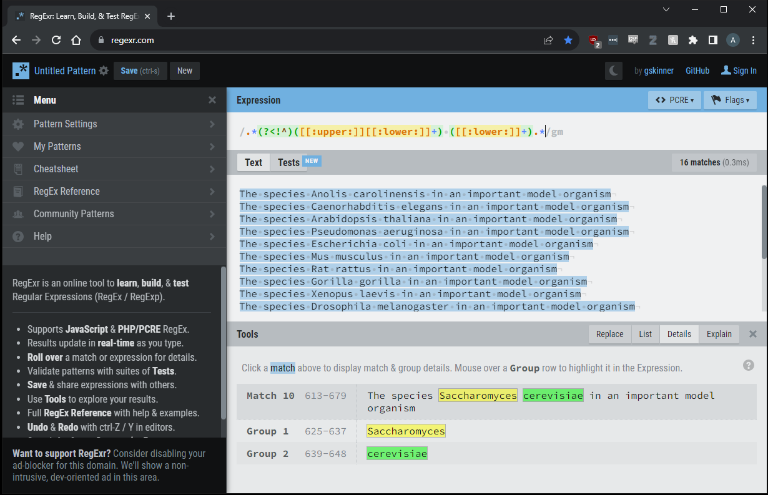
Demo: Regex experimentation with regexr.com
Data are in notes pane below slide
.*(?<!^)([[:upper:]][[:lower:]]+) ([[:lower:]]+).*
Set regex engine to PCRE
Activate multiline “flag”
Check out the “Details” and “Replace” tabs in the “Tools” pane.
Explore!
Notes:
The species Anolis carolinensis in an important model organism
The species Caenorhabditis elegans in an important model organism
The species Arabidopsis thaliana in an important model organism
The species Pseudomonas aeruginosa in an important model organism
The species Escherichia coli in an important model organism
The species Mus musculus in an important model organism
The species Rat rattus in an important model organism
The species Gorilla gorilla in an important model organism
The species Xenopus laevis in an important model organism
The species Drosophila melanogaster in an important model organism
The species Saccharomyces cerevisiae in an important model organism
The species Dictyostelium discoideum in an important model organism
The species Gallus gallus in an important model organism
The species Anolis carolinensis in an important model organism
The species Caenorhabditis elegans in an important model organism
The species Arabidopsis thaliana in an important model organism

Slide 51
End of Lesson

